Slide 1
FIFA WORLD CUP ANALYSIS
BY: ARPIT SHARMA

Slide 2
INTRODUCTION
The FIFA World Cup⚽🏆, often simply called the World Cup, is an international association football competition contested by the senior men's national teams of the members of the Fédération International de Football Association (FIFA), the sport's global governing body. The championship has been awarded every four years since the inaugural tournament in 1930, except in 1942 and 1946 when it was not held because of the Second World War. The current champion is Argentina 🏆, which won its third title at the 2022 tournament in Qatar.

Slide 3
PROJECT OBJECTIVE
Analyzing the datasets of FIFA World Cup⚽🏆, wherein we will try to find which country hosted most of the matches, which city hosted maximum matches, which country won the maximum matches and the World Cup🏆 and lot other factors.

Slide 4
APPROACH
In this project, I utilized the Microsoft Power BI intelligence tool and followed these steps to uncover insights on goal scoring and investigate key in-play metrics that influence goal scoring:
Data gathering
Data cleaning and preparation
Data Analysis
Data Visualization

Slide 5
Some of the variables in this dataset include:
Year — The year of the tournament.
Country — The host country of the tournament.
Winner — The team that won the tournament.
Runners-Up — The team that finished as the runners-up.
Third — The team that finished in third place.
Fourth — The team that finished in fourth place.
Goals Scored — The total number of goals scored in the tournament.
Qualified Teams — The total number of teams that qualified for the tournament.
Attendance — The total number of spectators who attended the matches.

Slide 6
CONCLUSION
1) Total of 850 matches ⚽ have been played 2) Most used stadiums were- a) Estadio Azteca with 19 matches⚽ b) Jalisco with 14 matches⚽ c) Olympia stadion with 14 matches⚽ d) Nou Camp with 11 matches⚽ 3) Top 3 teams to win the most World Cups🏆🏆are : a) Brazil with 5 World Cups 🏆 b) Italy with 4 World Cups 🏆 c) Germany with 4 World Cups 🏆

Slide 7
4) Most Goals⚽ scored in any World Cups were in- a) 2014 171 Goals b) 1998 171 Goals c) 2002 161 Goals 5) Teams who were the Runners Up for the most : a) Germany 4 times in 1962, 1982, 1986 and 2002 b) Argentina 3 times in 1930, 1990 and 2014 c) Netherland 3 times 1974, 1978 and 2010
6) Countries who played maximum matches : a) Germany b) Brazil c) Mexico

Slide 8
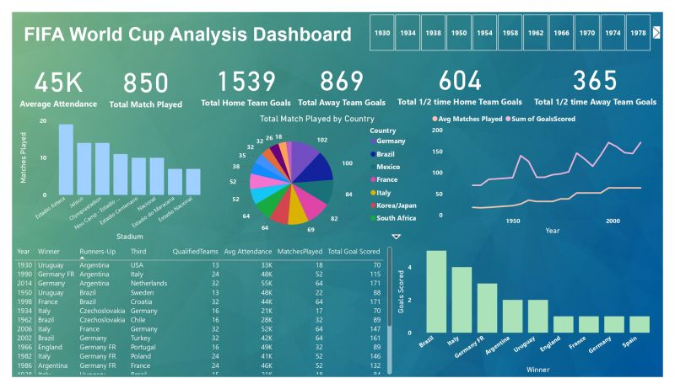

Slide 9
SPECIAL THANKS 🙏🏻
I would like to extend my heartfelt gratitude to Unified Mentor Private Limited for providing me with an incredible internship opportunity. The supportive and dynamic environment fostered by Unified Mentor Private Limited has enabled me to enhance my skills, gain hands-on experience, and contribute meaningfully to ongoing projects. The guidance and mentorship provided by the team have been instrumental in shaping my understanding and application of theoretical knowledge.
Thank you, Unified Mentor Private Limited, for this enriching opportunity and for playing a pivotal role in my career journey

